Slide 1
Alcohol trends and public attitudes
Dr Jean Long
With assistance from:
Dr Deirdre Mongan
Dr Justine Horgan

Slide 2
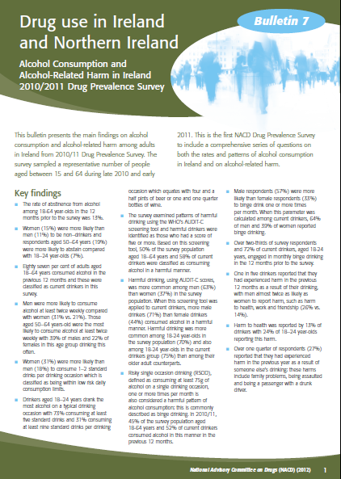
Alcohol consumption among adults aged 18-64
87% (89% males, 85% females) were current drinkers
31% of men and 21% of women consumed alcohol at least twice weekly
27% consumed 7+ standard drinks/drinking occasion
45% engaged in binge drinking at least once per month in the year prior to the survey - 52% of recent drinkers
50% scored positive for harmful drinking using the AUDIT-C screening tool -58% of recent drinkers
20% experienced at least one of six harms as a result of their drinking
27% experienced harm as a result of someone else’s drinking
Available at http://www.drugsandalcohol.ie/18439/
Notes:
Alcohol results from the NACD 2010/11 Drug Prevalence Survey
87% (89% males, 85% females) were current drinkers
Highest among females aged 18-24 years (94%)
Lowest among females aged 50-64 years (79%)
31% of men and 21% of women consumed alcohol at least twice weekly
Highest among males 18-24 years (60%) and 25-34 years (48%)
27% consumed more than 7+ standard drinks/drinking occasion
75g of pure alcohol on a single drinking occasion. This corresponds to four pints of beer or seven pub measures of spirits or one 750ml bottle of wine. There is no definitive guidelines on what constitutes RSOD; for this survey 75g was used to denote RSOD as this is the definition which was used by the European Comparative Alcohol Study2 and has been used in a number of Irish drinking surveys. According to the European Commission, RSOD at least once a month in the previous year can be considered a harmful drinking pattern.
45% engaged in binge drinking at least once per month in the year prior to the survey - 52% of recent drinkers
50% scored positive for harmful drinking using the AUDIT-C screening tool -58% of recent drinkers
20% experienced at least one harms as a result of their drinking
Six harms – harm to health, home life, work, friendships, being involved in an accident or fight
27% experienced harm as a result of someone else’s drinking
Five harms – family and money problems, being assaulted, being a passenger with a drunk driver, property vandalised
Representative sample 4,843 respondents aged 18-64 years
Fieldwork Oct 2010 – June 2011
Response rate – 60%

Slide 3
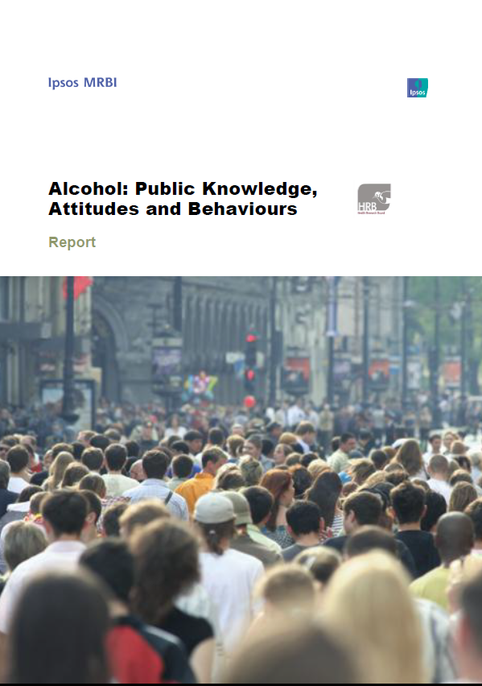
Alcohol: the public’s knowledge, attitudes & behaviours
Ipsos MRBI collected and analysed the survey data
HRB assisted with questionnaire design, requested gender and age analysis, and helped interpret survey findings

Slide 4
Objective
The Health Research Board commissioned Ipsos MRBI
to measure adults’ knowledge of, attitudes & behaviours towards alcohol
Notes:
In April 2012, the Department of Health asked the Health Research Board to ascertain the knowledge, opinions and behaviours of the general public in relation to alcohol consumption and whether they agreed or disagreed with the some of the specific measures in the recently published Report of the Working Group on a National Substance Misuse Strategy (for alcohol).
We broadened the scope to include all the measures that the DOH are responsible for and some of the measures that the HSE are responsible for. We developed a draft questionnaire with input from the HSE and other similar surveys.
.

Slide 5
Method
Questionnaire
National quota sample survey of 1,020 adults aged 18 years and over
Interviews were conducted using a face-to-face approach, at home addresses between 16th and 25th May
Each interview took 15 minutes to complete
Notes:
We commissioned Ipsos MRBI to do the survey. Ipsos MRBI redrafted the questionnaire and ensured each question was phrased in a neutral manner. They laid out the questions to facilitate easy, objective, and consistent administration for the respondents and the interviewees. Ipsos MRBI collected the survey data.
Ipsos MRBI used their national quota survey methodology and their trained interviewers to implement the survey. The findings of this survey are consistent with surveys among general population (SLAN and NACD) and school children (ESPAD) and Alcohol Action Irelands knowledge, attitudes and behaviours survey.
It was administered to a national quota sample of 1,020… representative of the 3.4 million adults aged 18 years and over… covering 100 sampling points throughout Ireland
Interviews were conducted using a face-to-face approach, at home addresses between 16th and 25th May, and took approximately 15 minutes to complete.

Slide 6
Comparison of sample, unweighted and weighted, with census
Notes:
At the request of the HRB, Ipsos MRBI weighted the data using the Census 2011 and analysed each question by gender and age. The proportion of people who do not drink alcohol (at 17%) is consistent with the 2007 SLAN survey (at 19%)… not shown in figure.

Slide 7
Consumption Measures of consumption Government intervention Pricing Advertising Sponsorship Driving Information labels on products Paying for the consequences of consumption Available at http://www.drugsandalcohol.ie/18022/
Findings
Presented in nine alcohol-related themes:
Notes:
The key findings are presented in a number of themes. Only a selection of the findings are reported in the presentation.
The report presents all the findings, the questionnaire, interviewer written briefing and relevant references and is available at http://www.drugsandalcohol.ie/18022/.

Slide 8
Alcohol consumption
Strong belief (85%) that the current level of alcohol consumption in Ireland is too high
General perception (73%) that Irish society tolerates high-levels of alcohol consumption
Considerable majority (72%) say they know someone who, in their opinion, drinks too much alcohol
Of those who know someone who drinks too much, 42% say that the person is an immediate family member
Notes:
There is a strong belief among 1,020 survey respondents (85%) that the current level of alcohol consumption in Ireland is too high and a general perception (73%) that Irish society tolerates high levels of alcohol consumption. A considerable majority (72%) say they know someone who, in their opinion, drinks too much alcohol, and of the 744 respondents who know someone who drinks too much, 42% say that the person is an immediate family member.

Slide 9
Measuring person alcohol consumption a standard drink is 10 grams of alcohol which is equivalent to one half pint of beer, one pub measure of spirits or 100 ml of wine
Notes:
When measuring person alcohol consumption in Ireland, a standard drink is used… a standard drink is 10 grams of alcohol which is equivalent to one half pint of beer, one pub measure of spirit and 100 ml of wine… The normal small wine glass contains about 150 ml which is 1.5 standard drinks… and the more modern larger wine glass would contain 200 ml of wine which is 2 standard drinks

Slide 10
Measuring personal alcohol consumption
58% have heard of the term ‘standard drink’
9% of respondents correctly identified the number of standard drinks in each of the four measures of alcohol asked about in the survey
9% know the maximum weekly number of standard drinks recommended for men and for women
Notes:
Measuring person alcohol consumption
Almost 6 out of 10 (58%) have heard of the term ‘standard drink’.
Before proceeding to the next question, all respondents were provided with a definition of the term “standard drink” – “A standard drink is a term used to measure the amount of alcohol in an alcoholic drink”. Respondents were then asked the number of standard drinks in four alcoholic drinks of various measures.
Nine per cent of respondents correctly identified the number of standard drinks in each of the four measures of alcohol asked about in the survey. The levels of understanding of the weekly maximum number of standard drinks recommended for either men or women are very low at nine per cent for each.

Slide 11
Government intervention
58% do not think that the government is doing enough to reduce alcohol consumption while only 19% think that the government is doing enough
78% believe that the government has a responsibility to implement public health measures to address high alcohol consumption
Notes:
Almost 6 out of 10 (58%) do not think that the government is doing enough to reduce alcohol consumption while only 19% think that the government is doing enough. Over three-quarters (78%) believe that the government has a responsibility to implement public health measures to address high alcohol consumption and there is support for implementing some of the specific measures in the recently published Report of the Working Group on a National Substance Misuse Strategy (for alcohol).

Slide 12
Alcohol pricing trends
76% have purchased alcohol in a supermarket in the past few years. Of these 777 respondents:
52% believe that the price has decreased
23% believe that it has remained the same
17% believing that the price has increased.
Of the 403 respondents noticing a decrease in the price
25% say that they have increased the amount they purchase
Highest among those aged 34 years or under (at 34%)
If the price in supermarkets was to decrease:
24% would buy more alcohol
50% of those aged between 18-24 years claim they would buy more
Notes:
Alcohol pricing
Around three-quarters (76%, 777) have purchased alcohol in a supermarket in the past few years. Just over half (52%) of these respondents believe that the price of alcohol has fallen in supermarkets, with almost one quarter (23%) believing that it has remained at the same price and 17% believing that the price has increased. Of those noticing a decrease in the price of alcohol, one quarter (25%) say that they have increased the amount they purchase and this is more common among those aged 34 years or under (at 34%).
In general, 24% would buy more alcohol in supermarkets if the price was to decrease. Half of those aged between 18-24 years claim they would buy more alcohol if supermarkets decreased prices.

Slide 13
Alcohol pricing sensitivity
It would require a:
25% price increase to get 67% of those purchasing alcohol in a supermarket to decrease the amount of alcohol purchased.
10% price increase to get 35% of those purchasing alcohol in a supermarket to decrease the amount of alcohol purchased
45% agree that that they buy more when alcohol is on special offer or when the price is reduced and 39% disagree
65% of those aged 18-24 years agree with the statement
Notes:
It would require a 25% price increase to get at least two-thirds (67%) of those purchasing alcohol in a supermarket to decrease the amount of alcohol purchased.
For example, a 25% increase on an average bottle of wine priced at €6.99 would increase its price to €8.74 and 67% of people (who would buy it at €6.99) would buy that bottle less often.
Only one-third (35%) would change their behaviour at a 10 per cent price increase.
Opinion is somewhat divided on whether special offers or price reductions encourage respondents to buy more alcohol than usual with 45% agreeing that they buy more alcohol and 39% disagreeing. Those aged 18-24 years are most likely to respond to such promotions with almost two-thirds (65%) saying that they buy more when alcohol is on special offer or when the price is reduced. This decreases with age
The majority (66%) believe that distance sales are an easy way for young people to obtain alcohol and only 15% believe that distance sales are strictly monitored.

Slide 14
Alcohol pricing responses
58% of respondents support minimum unit pricing for alcohol
Support strongest among those aged between 35-64 years at 65%
21% would not support a minimum price for alcohol
Lack of support highest among those aged 18-24 years at 33%
47% agree that the government should reduce the number of outlets selling alcohol while 28% disagree,
Agreement is strongest among women (50%) and those over 44 years (54%)
40% agree with selling alcohol in a separate premises to food and other household products while 32% disagree.
Notes:
Almost 6 out of 10 (58%) respondents support minimum unit pricing for alcohol. Support is strongest among those aged between 35-64 years at 65%. Over one-fifth (21%) would not support a minimum price for alcohol, with the lack of support (at 33%) highest among those aged 18-24 years. It is generally accepted that the greater the increase in alcohol prices the greater the reduction in purchasing and this has most effect on younger and heavy drinkers.
Forty seven per cent agree that the government should reduce the number of outlets selling alcohol while 28% disagree, with support strongest among women and older age groups.
Forty per cent agree with separating the sale of alcohol from food and other household products while 32% disagree.

Slide 15
Alcohol consumption and driving
75% do not agree that it is safe to drive after one alcoholic drink
Females (80%) are more likely to disagree that it is safe than males (69%)
90% do not agree that it is safe to drive after two alcoholic drinks.
Gender difference is no longer evident
94% agree that there should be mandatory testing of drivers’ alcohol levels when involved in traffic accidents
84% agree that those convicted of drink driving on more than one occasion should have an ‘alcohol lock’ fitted in their car
Notes:
Alcohol consumption and driving
There is good knowledge about the dangers of driving a vehicle under the influence of alcohol and there is strong support for measures to detect and deter such driving practices. Overall, three-quarters (75 per cent) do not agree that it is safe to drive after one alcoholic drink. Females are more likely to disagree that it is safe than males. Nine out of 10 (90 per cent) do not agree that it is safe to drive after two alcoholic drinks. The gender difference seen in terms of driving after one alcoholic drink is no longer evident. There is near universal support (94%) for the mandatory testing of drivers’ alcohol levels when involved in traffic accidents. Over 8 out of 10 (84%) agree that those convicted of drink driving on more than one occasion should have an ‘alcohol lock’ fitted in their car. No differences by gender or age were found.

Slide 16
Alcohol advertising
78% believe that alcohol advertising should be limited to the product itself rather than the type of person who consumes the brand
80% support banning alcohol advertising in cinemas before screening movies rated as suitable for viewing by those aged 17 years or under
76% support not allowing any alcohol advertising on TV and radio before 9pm.
70% support banning alcohol advertising on social media
57% support a ban on alcohol advertising on billboards and at bus stops
Support is highest among females and increases with increasing age
Notes:
Advertising alcohol
The majority support restricting many forms of alcohol advertising and two-fifths (40%) support a ban on all alcohol advertising.
Almost 8 out of 10 (78%) believe that alcohol advertising should be limited to the product itself rather than the type of person who consumes the brand. Eighty per cent support banning alcohol advertising in cinemas before screening movies rated as suitable for viewing by those aged 17 years or under. Seventy six per cent support not allowing any alcohol advertising on TV and radio before 9pm. In total 70% support banning alcohol advertising on social media and 57% support a ban on alcohol advertising on billboards and at bus stops.

Slide 17
Alcohol industry sponsoring events
42% support a ban on the alcohol industry sponsoring sporting events
37% support a ban on sponsoring musical events
Support is higher among women and in the older age groups (45s and over)
Females Sport (49%) Music (45%)
Age over 44 years Sport (47%) Music (46%)
Lack of support is more common among men and those aged 44 years or under
Males Sport (54%) Music (57%)
Age under 45 years Sport (51%) Music (59%)
Notes:
Overall, two-fifths (42%) support a ban on the alcohol industry sponsoring sporting events and over one-third (37%) support a ban on sponsoring musical events. Support is higher among women and in the older age groups (over 45s). Lack of support is more common among men and those aged 44 years or under. Lack of support for such a ban may be due to a perceived shortage of alternative funders or a lack of knowledge that one of the uses of the proposed social responsibility levy could be to help sponsor such events.

Slide 18
Information labels on alcohol products
The vast majority of respondents want information on alcohol products:
Alcohol strength (98%)
Details of alcohol-related harms (95%)
List of ingredients (91%)
Number of calories (82%)
Notes:
There is a desire for better labelling of alcohol containers with very strong support for all four forms of information, asked about, on the labels of alcohol containers. The vast majority of respondents want information on the alcohol strength (98%), details of alcohol-related harms (95%) a list of ingredients (91%) and the number of calories (82%).

Slide 19
Paying for the health consequences of alcohol consumption
61% believe that people who drink alcohol should contribute to the health-related costs of excessive alcohol consumption
42% believe that the alcohol industry should contribute to these costs
27% believe that the State, through taxation, should contribute to these costs
Notes:
The alcohol industry say that they pay 2 billion to the exchequer each year, actually the most recent figure is 1.8 billion, … but many taxpayers may not realise that the state sponsored health, social and policing services, which taxpayers finance, pay 3.7 billion to deal with the consequences of alcohol… a shortfall of 1.7 billion
A HSE commissioned report showed that in 2007, the health-related costs of alcohol were €1.2 billion.
Sixty one per cent believe that people who drink alcohol should contribute to the health-related costs of excessive alcohol consumption. Forty two per cent believe that the alcohol industry should contribute to these costs. Only 27% believe that the State, through taxation, should contribute to these costs.

Slide 20
Paying for the social consequences of alcohol consumption
71% believe that people who drink alcohol should contribute to the social costs of excessive alcohol consumption
30% believe that the alcohol industry should contribute to these costs
22% believe that the State, through taxation, should contribute to these costs
Notes:
The same study showed that public disorder-related costs in 2007 also amounted to €1.2billion. As with the health-related costs of excessive drinking, the majority believe that those who drink alcohol (71%) followed, to a lesser extent, by the alcohol industry (30%) and then the State through taxation (22%) should contribute to the costs of alcohol-related public disorder, relationship difficulties and financial loss.

Slide 21
Health effects of alcohol
21
Q.27 For each of the following statements, can you tell me whether you think they are true or false?
 | True | False | Don’t Know
 | % | % | %
Drinking more than the recommended number of standard drinks in a week …
…can lead to liver disease | 92 | 2 | 6
... can lead to pancreatitis | 84 | 3 | 12
…can lead to stomach ulcers | 84 | 4 | 12
…can lead to high blood pressure | 80 | 6 | 13
…can increase a woman’s risk of breast cancer | 49 | 19 | 32
…can increase risk of skin cancer | 32 | 35 | 33
…can increase risk of bowel cancer | 65 | 10 | 25
Cells shaded wine indicate correct answer
In general, there is good knowledge about the common diseases associated with alcohol consumption such as its effects on the liver (92%), pancreas (84%) and blood pressure (80%). Knowledge about alcohol’s association with breast cancer (49%) and bowel cancer (65%) is less well understood though there is evidence for the links.
Base: All Respondents: 1,020
Notes:
Ipsos MRBI: Report Title 21
In general, there is good knowledge about the common diseases associated with alcohol consumption such as its effects on the liver (92%), pancreas (84%) and blood pressure (80%). Knowledge about alcohol’s association with breast cancer (49%) and bowel cancer (65%) is less well understood though there is evidence for the links.

Slide 22
Conclusions

Slide 23
Conclusions
Survey findings are consistent with general population surveys, surveys among school children and other public opinion surveys
Strong belief among survey respondents that the current level of alcohol consumption in Ireland is too high
Majority do not think that the government is doing enough to reduce alcohol consumption
Three-quarters believe that the government has a responsibility to implement public health measures to address high alcohol consumption
Notes:
Conclusions
The survey findings are consistent with general population surveys, surveys among school children and other public opinion surveys. There is a strong belief among survey respondents that the current level of alcohol consumption in Ireland is too high. The majority do not think that the government is doing enough to reduce alcohol consumption. Over three-quarters believe that the government has a responsibility to implement public health measures to address high alcohol consumption and there is support for implementing some of the specific measures in the recently published Report of the Working Group on a National Substance Misuse Strategy (for alcohol).

Slide 24
Conclusions cont.
Considerable support for implementing some of the specific measures in the recently published Report of the Working Group on a National Substance Misuse Strategy
Labels on alcohol containers contain calories, alcoholic strength, ingredients and health warnings (82%-98%)
Measures to deal with alcohol and driving (84%-94%)
Restrictions on advertising: (57%-80%)
Minimum price (58%)
People who drink alcohol (61% -71%) and the alcohol industry should contribute to the costs (30-42%)
Government should reduce the number of outlets selling alcohol (47%)
Selling alcohol in a separate premises to food and other household products (40%)
Industry should not sponsor sports (42%) and music events (37%)
Notes:
The support for the measures in the Report of the Working Group on a National Substance Misuse Strategy
is as follows:

